Slide 1
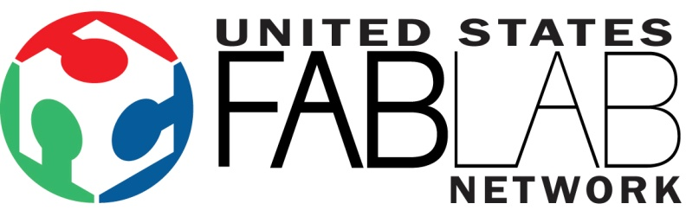

USFLN Mission
The United States Fab Lab Network (USFLN) promotes responsible collaboration in digital fabrication. It evolved in November 2009 from the regional Midwest Fab Lab Network (MFLN, formed in December 2006).
The mission of the USFLN, in the spirit of The (MIT) Fab Charter, is to support digital fabrication in academics, business, and community outreach:
  In academics, the USFLN encourages Fab Labs to engage students and teachers in Science, Technology, Engineering, and Mathematics (STEM), as well as other disciplines.
  In business, it promotes invention, entrepreneurship, and skills needed for a 21st-century global economy.
  In community outreach, it makes resources available to empower underserved and non-traditional populations.
The USFLN fosters innovation and creativity that contribute to the nation's
well-being. Membership is open to any person and/or organization that follows The (MIT) Fab Charter.
updated: January 27, 2011

Slide 2
Recent Activities
USFLN Mission revised & Membership Guidelines drafted, 1/2011. Available online: usfln.wordpress.com/about
2nd Annual Symposium, January 2011
  Two-and-a-half-day symposium held in Kansas City, Kansas. Hosted by Blue Valley CAPS (Center for Advanced Professional Studies) – www.bvcaps.org.
  Presentations & speakers were broadcast via MIT MCU/Polycom.
1st (Pilot) Webinar: Fab Lab Lifecycle (Planning & Justification), May 2011
  First webinar in a two-part series. Hosted by MATEC – www.matecnetworks.org.
  Webinar guide and full webinar available online.
Kansas City Maker Faire, June 2011
  USFLN tent with members from Fab Labs across the US: Champaign-Urbana Community Fab Lab (Illinois), Lorain County Community College (Ohio), MC² STEM High School Mobile Fab Lab (Ohio), Chicago Museum of Science & Industry (Illinois), BV CAPS (Kansas), Metropolitan Community College (Missiouri), and Community College of Baltimore County (Maryland).
  Visited by Dale Dougherty (O’Reilly Media and MAKE magazine), and via polycom by Neil Gershenfeld & Sherry Lassiter.
  Partial sponsorship by Kauffman Foundation and TIES.
Independent consultant hired to revise mission, vision, & develop 5-year strategic plan to determine best ways to serve USFLN members.
A Few Upcoming Plans
Website revision – currently underway, to be launched end of August 2011
Digital Fabrication Learning Community project, 7/2011 – 6/2014
2nd Webinar: Fab Lab Lifecycle (Development and Sustainability) , Sept 2011
USFLN Symposium 2012: April 10th – 12th at Fab Lab Tulsa (Oklahoma)! fablabtulsa.org

Slide 3
Products Available
Three planning guides, developed as part of the Midwest Digital Fabrication Partnership grant from the National Science Foundation:
  Initial Planning Guide
  Fab Lab Introduction Guide
  Fab Lab Instruction Guide
  Available, at no cost, by request: www.usfln.org/docs/Guide%20request%20Form.pdf
Webinar Discussion Guide: usfln.files.wordpress.com/2011/05/webinar_may20_notesguide.pdf
Fab Lab Lifecycle (Planning & Justification) webinar recording:
Follow instructions at this blog post: usfln.wordpress.com/2011/05/25/webinar-recording-now-online
Project instructions available at PBWorks: fablabprojects.pbworks.com
Note: Follow the instructions to submit a request to the administrator in order to gain access.
Resources
USFLN website: www.usfln.org
USFLN blog/transition site: usfln.wordpress.com
USFLN Facebook page: www.facebook.com/pages/United-States-Fab-Lab-Network/109746082421001
USFLN on Twitter: twitter.com/#usfln

